Slide 1
Base Your Database
Session 1

Slide 2
Introduction to Databases & NoSQL with MongoDB
By : Abdalrahman Khaled

Slide 3
Table of contents
01
02
03
Introduction
What Is a Database?
Types of Databases
04
05
06
Introduction to NoSQL
Why MongoDB?
MongoDB Core Concepts

Slide 4
Table of contents
07
08
09
Schema:
SQL vs MongoDB
Basic CRUD Operations
MongoDB in Real Applications
10
11
12
Common Mistakes & When NOT to Use MongoDB
What’s Next?
Closing
Notes:
Roles Deep explain about nosql tyes and how they work internally

Slide 5
Final Outcome of This Session
By the end of this session, attendees will:
Understand what databases are
Know why NoSQL exists
Understand MongoDB concepts
Be ready to mentally switch to SQL next

Slide 6
01
Introduction
About the Event

Slide 7

Backend
S&T

Slide 8
What this database event is about
Understanding how data is stored
Exploring different database models
Learning when to use each technology
Building a strong foundation
This is not about tools only , it’s about mindset.

Slide 9
The Event Roadmap
01
02
03
04
indexing & Query Optimization
NoSQL
DB Design
PostgreSQL
07
06
05
Caching
ORM
Transactions & ACID

Slide 10

Rules
Not attending a session without good excuse BEFORE the session -> warning
Missing a Task without good excuse -> warning
Arriving late after 7 mins -> pay the fee
Fee -> 1 min = 1 pound (max 15 pound)

Slide 11

Rules
Best of the week will be announced at the end of each week on the community and discord
Best of the camp will be awarded at the end of the camp!

Slide 12
Table of contents
01
02
03
Introduction
What Is a Database?
Types of Databases
04
05
06
Introduction to NoSQL
Why MongoDB?
MongoDB Core Concepts

Slide 13

02
What is DataBase?

Slide 14
Let’s go back a little bit …
Before computer existed!

Slide 15


Slide 16
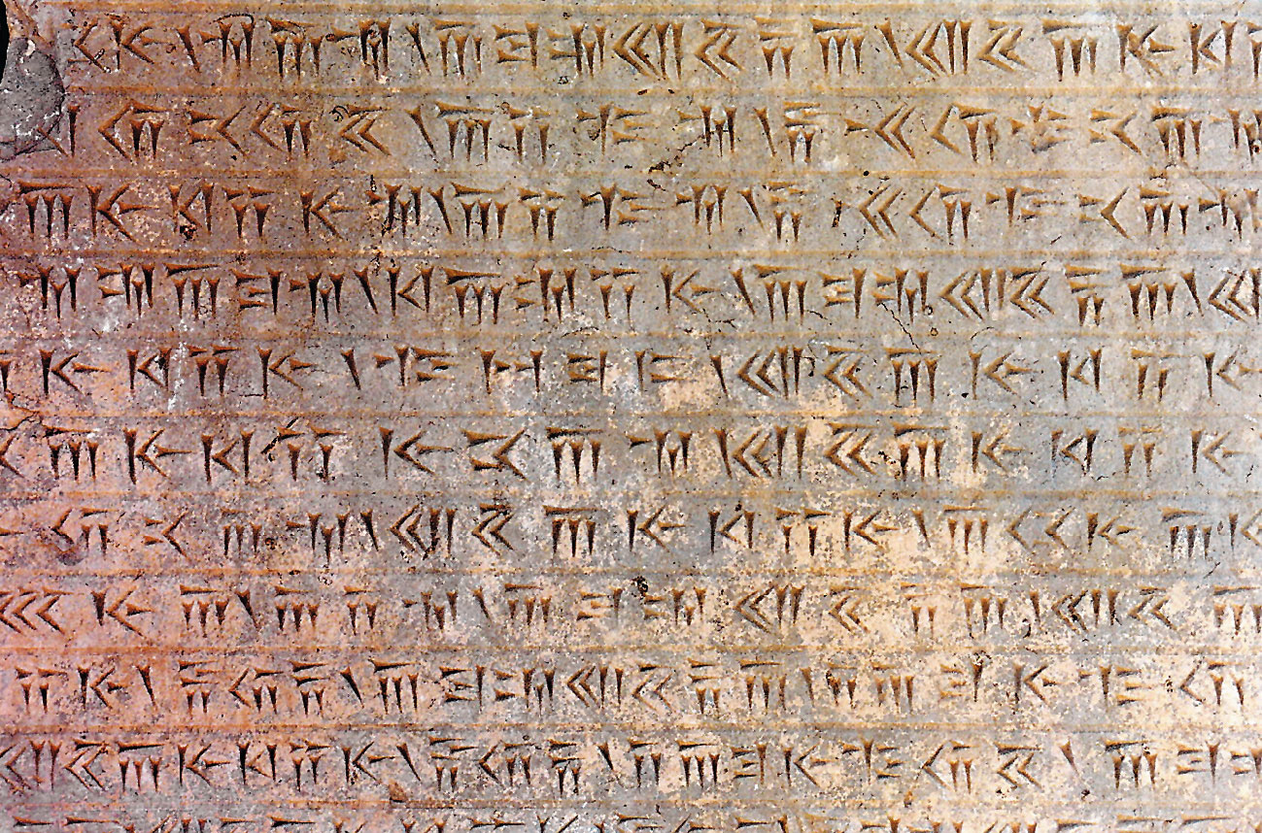
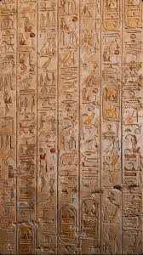
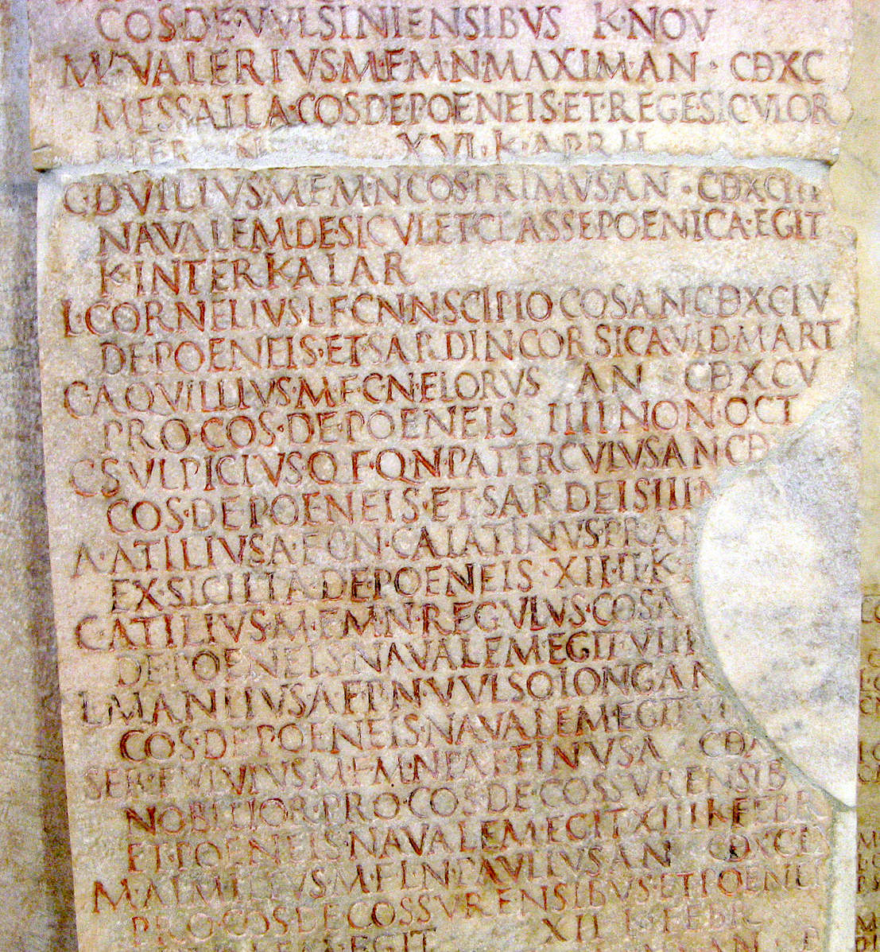
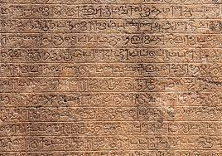

Slide 17
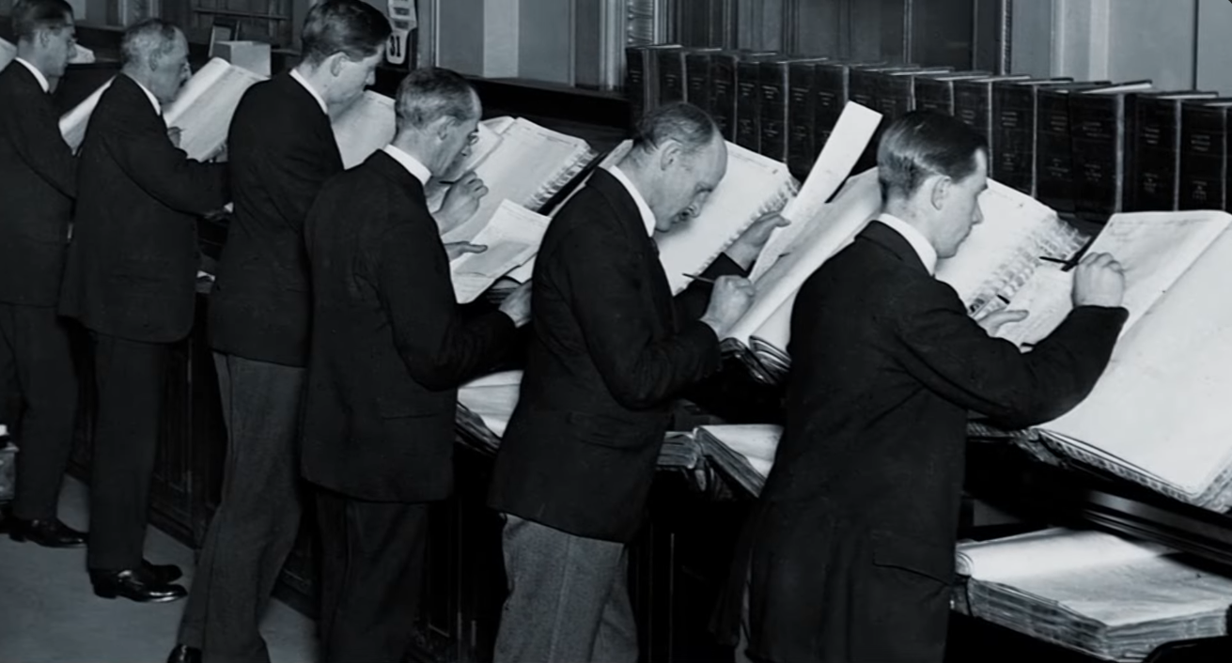

Slide 18


Slide 19
How Was Data Stored Back Then?
Ancient Egyptian walls
Mesopotamian / Iraq clay tablets
Paper records
Ledgers and notebooks
Filing cabinets
Index cards
Searching took a long time
Data was duplicated
Easy to lose or damage
Only one person at a time
Problem
CTRL + F did not exist :)

Slide 20
Let’s go to the time after computers were invented!

Slide 21


Slide 22
Flat File Model

Slide 23
Enter Computers
Data moved from paper to digital
Files replaced folders
Faster processing
Same problems , new medium.

Slide 24
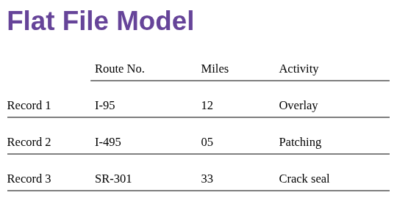

Slide 25
What is the Flat File Model?
You have one big file (or many separate files), and all data is written directly inside them.
EX: Text files, CSV files
Flat = no layers, no logic, no connections, no relationships.
Same problems , new medium.
Computers changed the tool, not the problem

Slide 26
Problems with Flat Files
Data duplication
Hard to update
Inconsistent data
No structure enforcement
Notes:
To search for a record the computer has to do sequential search (which is slow)

Slide 27
Hierarchical and Network Models (Mid-1960s)

Slide 28
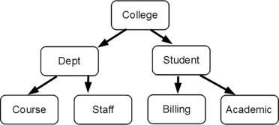
Hierarchical Model
IBM introduced the Information Management System (IMS).
which used a hierarchical "tree" structure where parent nodes pointed to child nodes.
While successful for projects like NASA’s lunar lander, it was rigid.

Slide 29
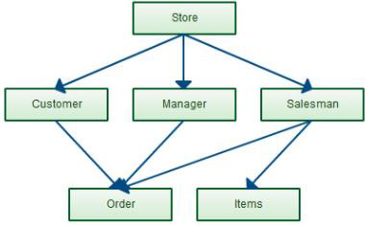
Network Model
A more flexible network model was developed by Charles Bachmann at GE.
allowing child nodes to have multiple parents.
but it became too difficult to manage as the pointers between data grew complicated

Slide 30
The Relational Breakthrough (1970)

Slide 31
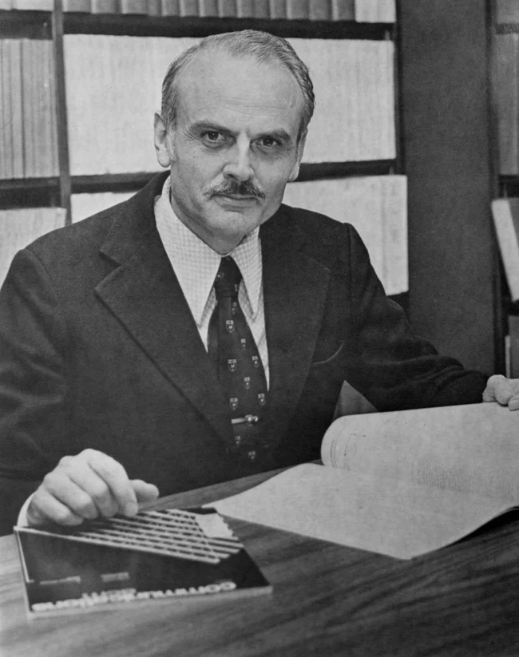
The Relational DB
IBM scientist Ted Codd proposed the relational database model
which organized data into simple tables.
This eliminated the need for complex pointers because tables connected through matching data fields, making it much easier to access and change information.

Slide 32
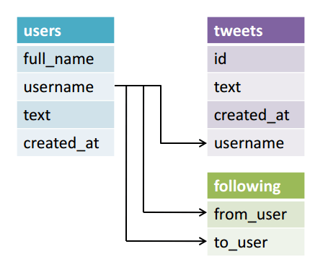
The Relational DB
Despite its brilliance, IBM was slow to adopt it because it competed with their profitable IMS product

Slide 33
Commercialization and Competition (1973–1979)

Slide 34

Commercialization and Competition
1973 (The Foundation): Researchers at UC Berkeley created Ingress, a database that many other companies used to build their own products.
1975 (The Language): IBM created an experimental system called System R, which introduced SQL, the standard language still used today to search and change data.
1977–1979 (The Competition):
Larry Ellison saw the opportunity and started his own company to build a compatible database.
He released Oracle in 1979, beating IBM to the public market by several years
Notes:
Ellison saw IBM’s "System R" experiment and decided to build a version people could actually buy. Because it was compatible with IBM’s system but released years before IBM’s own product, Oracle took over the market

Slide 35
Modern Dominance (1983–Present)

Slide 36

Oracle
1983 (The Market Shift):
Oracle had updated its software to run on almost every computer, including IBM’s own machines.
By the time IBM finally released its own commercial version (DB2), Oracle had already captured the market and was selling to IBM’s own customers.
Today:
Because of this early competition, relational databases became the global standard.
They now organize the data we use for almost everything, including shopping, working, and communicating

Slide 37
The Rise of NoSQL (Late 2000s)

Slide 38
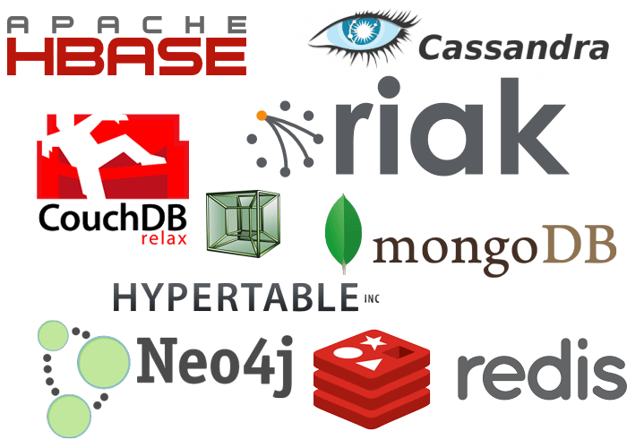
NoSQL
As the internet grew, companies like Google and Amazon needed to handle massive amounts of unstructured data (like social media posts or images) that didn't fit easily into relational tables.
NoSQL ("Not Only SQL") databases emerged to provide a more flexible way to store data that could be easily spread across thousands of servers, prioritizing speed and scale over the strict table structures of the relational model.

Slide 39
Summary
Pre-Computer
Relational DB
Early Computer Models
Non-Relational DB

Slide 40
Summary
Databases existed long before computers
Computers changed the medium, not the problem
Flat files stored data, but didn’t manage it
Databases were invented to:
Organize data
Prevent duplication
Enable fast search
Support multiple users

Slide 41
Table of contents
01
02
03
Introduction
What Is a Database?
Types of Databases
04
05
06
Introduction to NoSQL
Why MongoDB?
MongoDB Core Concepts

Slide 42
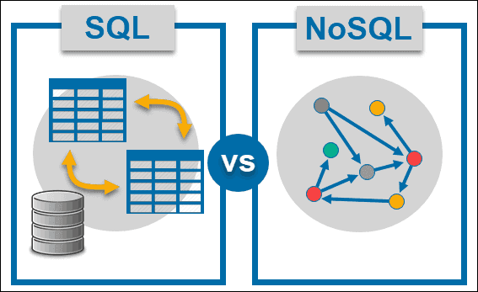
Are All Databases the Same?
Different problems
Different data shapes
Different scale requirements
Main Types of Databases:
Relational Databases (SQL)
Non-Relational Databases (NoSQL)

Slide 43
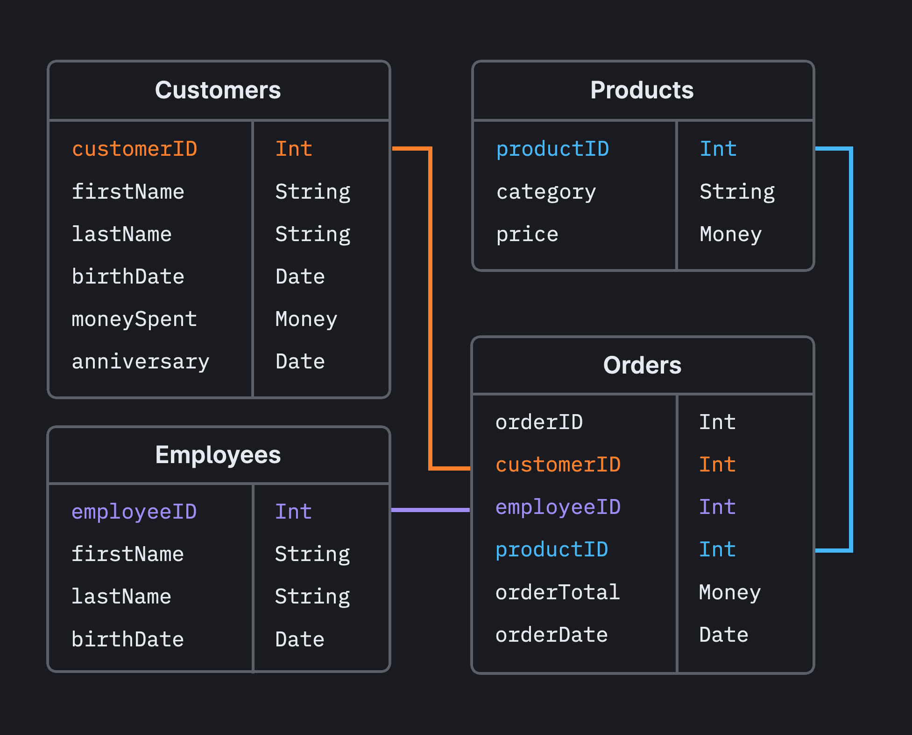
Relational Databases (SQL)
Data stored in tables
Fixed schema
Strong relationships
ACID guarantees
Notes:
Atomicity ("All or Nothing"): A transaction is treated as a single unit. If any part fails, the entire transaction fails and is rolled back.
Consistency: Ensures a transaction brings the database from one valid state to another, following all rules, constraints, and triggers.
Isolation: Concurrent execution of transactions leaves the database in the same state as if they were executed sequentially, preventing interference.
Durability: Once a transaction is committed, it remains permanent, even in the event of a system crash or power loss.

Slide 44
What Is SQL?
Structured Query Language
SQL is not a database. It’s a language.
A language to talk to databases
Used to store, read, update, and delete data
Works with relational databases
Not a programming language like Java or Python

Slide 45
Why Was SQL Invented?
Data stored in tables
Humans need a simple way to ask questions
Databases need a standard way to understand requests
SQL exists to ask questions about data.

Slide 46



SQL DBMS Examples
PostgreSQL
MySQL
SQLite
Oracle

Slide 47
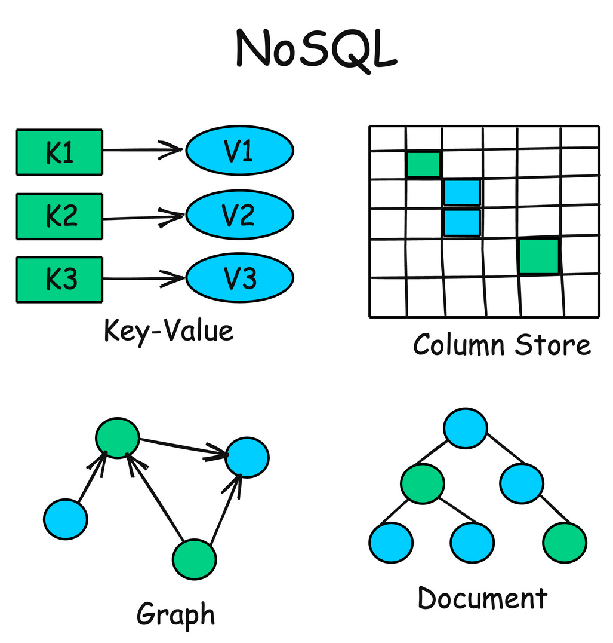
Non-Relational Databases (NoSQL)
Flexible schema
Different data models
Designed for scale
High availability

Slide 48
What Is NoSQL?
A way to store and access data
Designed for flexibility and scale
Uses different data models
Often used in modern applications
NoSQL is a category, not a tool.

Slide 49
Why Was NoSQL Invented?
Data became large and diverse
Schemas changed frequently
Systems needed to scale horizontally
Performance under high traffic mattered
NoSQL exists to handle scale and flexibility.

Slide 50




NoSQL DBMS Examples
Document → MongoDB
Key-Value → Redis
Column → Cassandra
Graph → Neo4j

Slide 51


Slide 52
Terminologies Alert
What is the difference between :
(Relational-non Relational)Databases and DBMS and SQL and NoSQL

Slide 53
Terms
Databases
DBMS
Is the Data.
A database is just organized data stored somewhere.
is the software that manages that data.
This is the software that:
Stores the database
Protects it
Organizes it
Controls access to it
DBMS = the manager of the data

Slide 54
Terms
SQL
NoSQL
is the language.
Used to communicate with the DBMS
To tell it what you want to do with the data
SQL = how you talk to the DBMS
is a category of databases.
Not Only SQL
It refers to databases that are not based on the relational table model.

Slide 55

So, When to use What?!

Slide 56
Use a Relational DB (SQL) when…
Data has strong relationships
Example:User → has many Orders Order → has many Products
Need strict consistency (ACID)
Example:
Banking system, Payment system, Inventory system
cannot afford:
double payments
lost transactions
Data structure is stable
If your tables:
rarely change structure
have clear schema follow
predictable patterns

Slide 57
Use Non-Relational DB (NoSQL) when…
Data is flexible or unstructured
Example:
Posts with different fields
User profiles with optional data
Need massive horizontal scaling If you're building:
Social media
Real-time analytics
IoT system
Logging platform
Don't rely heavily on JOINs
If your app mostly:
fetches full objects stores nested
data doesn’t require complex relational queries

Slide 58

Side Quest: Search about Hybrid Database architecture!

Slide 59

Another Side Quest: Create a practical decision file that helps any developer decide:
Should I use a Relational Database or a Non-Relational Database?

Slide 60
Summary
Database design didn’t start with just two types,Early models were structured, but rigid.
In 1970, the relational model was introduced,Tables and logical queries changed everything.
Relational databases dominated for decades.
Then data grew bigger and more complex,Applications needed more flexibility and scale.
New database models emerged,They became known as NoSQL.
Databases evolved as data evolved.

Slide 61
Table of contents
01
02
03
Introduction
What Is a Database?
Types of Databases
04
05
06
Introduction to NoSQL
Why MongoDB?
MongoDB Core Concepts

Slide 62
The internet changed, so databases had to change, too

Slide 63
NOSQL (Not Only SQL)
★ A category of databases designed for massive data volume and flexible structures.
★ moved away from one big server (vertical scaling) to distributing over a team of servers (horizontal scaling)
★ No complex tables linked by keys
★ You don't need to define every column before adding data

Slide 64
When to Use NOSQL?
Rapid development
Frequently changing data structure
High traffic systems
Large-scale distributed apps

Slide 65
NoSQL Is Not One Thing
Types of NoSQL Databases
Document
Key-Value
Column-Family
Graph
NoSQL is an umbrella term.

Slide 66
NoSQL Is Not One Thing
Today’s Focus: Document Databases
Among NoSQL models,
we’ll focus on the Document model ,using MongoDB.
What Is the Document Model? Data is stored as documents Instead of rows in tables
Each document is:
Self-contained
JSON-like
Flexible in structure

Slide 67
Table of contents
01
02
03
Introduction
What Is a Database?
Types of Databases
04
05
06
Introduction to NoSQL
Why MongoDB?
MongoDB Core Concepts

Slide 68
Why MongoDB?
MongoDB is the most popular DBMS for NoSQL Document model databases
Easy to learn and developer-friendly
Uses JSON-like structure
Widely used in modern web applications
Strong community & ecosystem

Slide 69
Table of contents
01
02
03
Introduction
What Is a Database?
Types of Databases
04
05
06
Introduction to NoSQL
Why MongoDB?
MongoDB Core Concepts

Slide 70
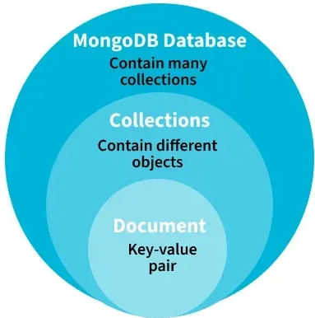
MongoDB Structure
How MongoDB Organizes Data:
→Database
→ Collections : Tables
→ Documents : Rows
→ Fields : Columns
Notes:
Show them an example on real data

Slide 71
MongoDB Structure
Documents can contain other documents -> Nested Document
Documents can store lists (Arrays)-> Relational databases would need separate tables
Flexible Schema
Every document has: "_id" This is MongoDB’s primary key
Unique identifier
Automatically generated
Used to retrieve documents
MongoDB stores data as flexible JSON-like documents.
Notes:
Show them an example on real data for every point

Slide 72
Table of contents
01
02
03
Introduction
What Is a Database?
Types of Databases
04
05
06
Introduction to NoSQL
Why MongoDB?
MongoDB Core Concepts

Slide 73
Table of contents
07
08
09
Schema:
SQL vs MongoDB
Basic CRUD Operations
MongoDB in Real Applications
10
11
12
Common Mistakes & When NOT to Use MongoDB
What’s Next?
Closing
Notes:
Roles Deep explain about nosql tyes and how they work internally

Slide 74
Schema : SQL vs MongoDB
What is a Schema?
A schema defines:
What fields exist
Their data types
Required vs optional
Relationships
A schema is the structure blueprint of your data.

Slide 75
SQL Schema (Strict)
Before inserting data, you must:
Define table
Define columns
Define data types
Define constraints
Structure first, data second.

Slide 76
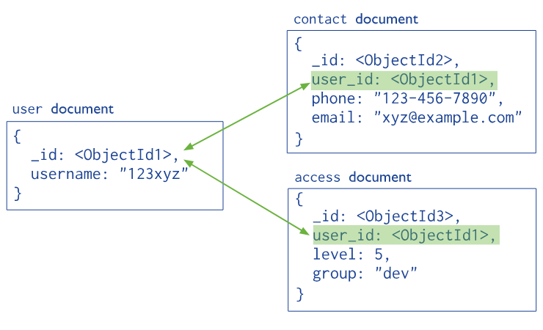
MongoDB Schema (Flexible)
No need to predefine structure.
Data first, structure optional.

Slide 77
MongoDB Schema (Flexible)
IMPORTANT NOTE:
MongoDB is schema-flexible,not schema-less.
You can:
Enforce schema using validation
Define structure at application level

Slide 78
Table of contents
07
08
09
Schema:
SQL vs MongoDB
Basic CRUD Operations
MongoDB in Real Applications
10
11
12
Common Mistakes & When NOT to Use MongoDB
What’s Next?
Closing
Notes:
Roles Deep explain about nosql tyes and how they work internally

Slide 79
Basic CRUD Operations
What is CRUD operations?
The Basic Operations that can be applied to Data
C → Create → Insert
R → Read → Find
U → Update → Update
D → Delete → Delete
Notes:
Show the CRUD operations in the Code

Slide 80
CODE!
Notes:
Show the CRUD operations in the Code

Slide 81
Table of contents
07
08
09
Schema:
SQL vs MongoDB
Basic CRUD Operations
MongoDB in Real Applications
10
11
12
Common Mistakes & When NOT to Use MongoDB
What’s Next?
Closing
Notes:
Roles Deep explain about nosql tyes and how they work internally

Slide 82
Where does MongoDB actually shine
MongoDB is strong when:
Data structure changes frequently
Rapid development is required
Applications scale horizontally
Data is naturally document-like

Slide 83
Where does MongoDB actually shine
Examples:
Social media platforms
Chat applications
Content management systems
Analytics dashboards

Slide 84
Table of contents
07
08
09
Schema:
SQL vs MongoDB
Basic CRUD Operations
MongoDB in Real Applications
10
11
12
Common Mistakes & When NOT to Use MongoDB
What’s Next?
Closing
Notes:
Roles Deep explain about nosql tyes and how they work internally

Slide 85
Common Mistakes
Ignoring schema design
Overusing embedding
No proper indexing
Treating it like SQL
Assuming it replaces relational databases

Slide 86
When NOT to Use MongoDB
Complex joins across many entities
Strict ACID financial systems
Strong relational integrity requirements
Heavy transactional systems
Banking systems → better suited for relational databases.

Slide 87
Trade-offs
MongoDB gives:
Flexibility
Horizontal scalability
But you give up:
Strong enforced relationships
Strict schema control
Traditional joins
Choose based on the problem

Slide 88
MongoDB is not better than SQL.
It’s better for certain problems

Slide 89
Table of contents
07
08
09
Schema:
SQL vs MongoDB
Basic CRUD Operations
MongoDB in Real Applications
10
11
12
Common Mistakes & When NOT to Use MongoDB
What’s Next?
Closing
Notes:
Roles Deep explain about nosql tyes and how they work internally

Slide 90

What’s Next?
Next session : Relational Database (SQL)

Slide 91
Next session will be next week , Study Well till then!
Do you Have any Questions?
Closing!

Slide 92
Resources
History of DBMS (GeeksforGeeks)
Database Types (Youtube video)
Ted Cod Paper: Relational Model of Data (pdf)
How do NoSQL databases work? (Youtube video)
What is a Document Database? (MongoDb Document)
What is a NoSQL? (MongoDb Document)
Types of databases (GeeksforGeeks)
IBM DOC about Relational Databases
Blog about the development of DB
MongoDB Document

Slide 93
Thanks!

Slide 94
Kahoot

